Slide 1

01/17
01/16
Bangladesh University Of Business And Technology
CSE100 Mini Project
Student Management System

Slide 2
02/17
02/16
Welcome To
Student Management System of BUBT

Slide 3
03/17
03
A Project on Student Management System
Present By Supervised By
Anika Tahsin Prokriti(19202103457) Umme Hafcha Mukti
Syed Samiul Houqe(19202103465) Course Instructor
MD. Shariar Rahman Oion (19202103458) Dept. Of CSE(BUBT)

Slide 4
04/17
04
Outline of This Presentation
Introduction
Objectives
Features
Program Tree
Flowchart
Motivation
Future Plan
Reference
Conclusion

Slide 5
05/17
05
Introduction
Introduce
Student management system is an environment where all the process of the student in the institution is managed.
Purpose
Scope

Slide 6
06/17
06
Objectives
To make the system computerize.
To reduce time consumption.
To reduce error.
To automate system managements.
To find information easily.
To modify any information quickly.

Slide 7
07/17
07
Us Featureses
The Key features of Student management system are:
Loading
Admin
Menu

Slide 8
Menu Features
08/17
08
Add Student
Modify Student
Show All Student
Individual View
Remove Student
Exit

Slide 9
9/17
09
Program Tree
Log In
Admin
Add Student
Modify Student
Student Management System
Show All Student
Individual
Student
Remove Student
Log Out

Slide 10
11/17
Sub-Features that represent out project
Modify Student
Roll
Add Student
CGPA
Name
CGPA
Name
SGPA
Show-All Student
Father Name
SGPA
Individual Student
Father Name
Roll
Mother Name
Roll
Mother Name
Section
Intake
Department
Section
Intake
Department

Slide 11
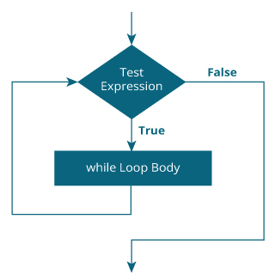
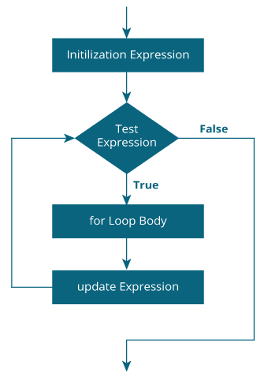
11/17
11
Flowchart
For loop : While loop:

Slide 12
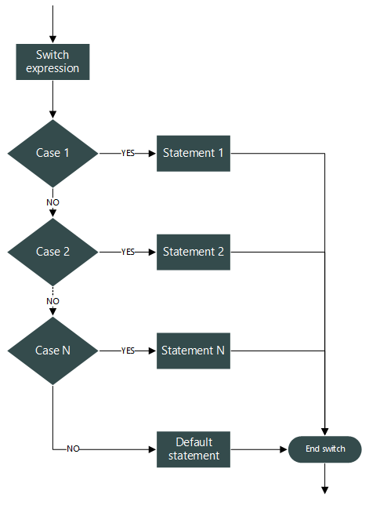
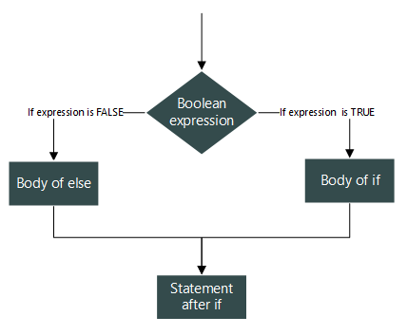
12/17
Switch Case :
If-Else :

Slide 13
13/17
MOTIVATION
1.All the student can get their information collectively.
2.Information can be found easily. It is a waste of time to get the information of a student from the office of the educational institution. We did this project without wasting time and easily finding out student information.

Slide 14


Future Plan
14/17
Adding Academic Information
Adding Routine
Adding Library
S | S | M | Tu | W | T | Fr

Slide 15
15/17
12
Reference
Website Reference:
https://codeprojects.org
https://www.wikipedia.org/
https://www.google.com/
https://www.geeksforgeeks.org/
http://edujournal.in/
http://freesourcecode.net/
https://www.youtube.com/

Slide 16
16/17
13
Conclusions
Our project ensure data safe and secure
Only admin have the main control over data
It is 100% safe and reliable

Slide 17
17/17
THANK YOU

